Slide 1


Prof. Dr. Hikmat Ullah Khan Department of Information Technology
Data Mining
Course outline, & motivation
University of sargodha

Slide 2

Lesson from Holy Quran

Slide 3

Outline
Introduction to Data Mining
DM in CS Domain
Turing Test
Applications and Significance
Evolution of Sciences
From Empirical to Data Science era
Semester Planning
Course Outlines
Libraries and Tools
Data Resources and Learning Sources
Marks Distribution

Slide 4
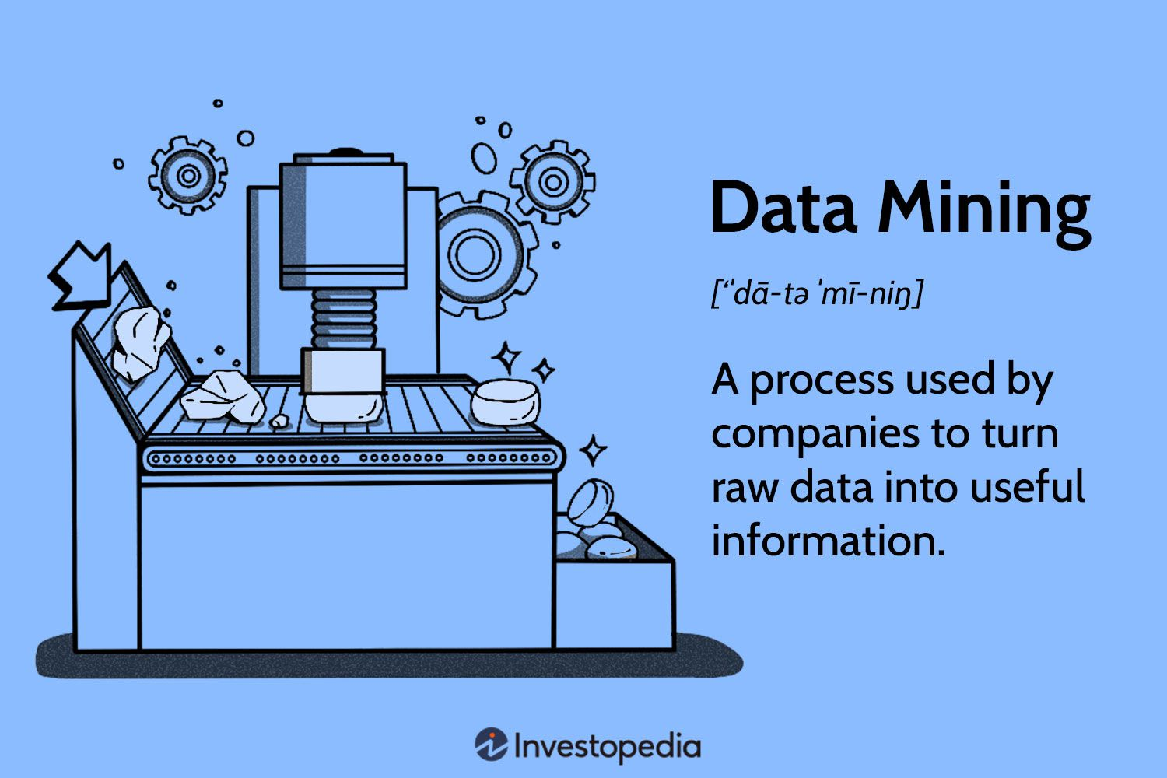
What is Data Mining

Slide 5
Evolution of Sciences
Before 1600, empirical science
1600-1950s, theoretical science
Each discipline has grown a theoretical component. Theoretical models often motivate experiments and generalize our understanding.
1950s-1990s, computational science
Over the last 50 years, most disciplines have grown a third, computational branch
Computational Science traditionally meant simulation.
1990-now, data science
The ability to store and manage a large volume of data online, Big Data
The Internet makes all these archives universally accessible , IoT to IoE
Human can not process huge volume, Data Mining/ML tasks - a major new challenge!

Slide 6
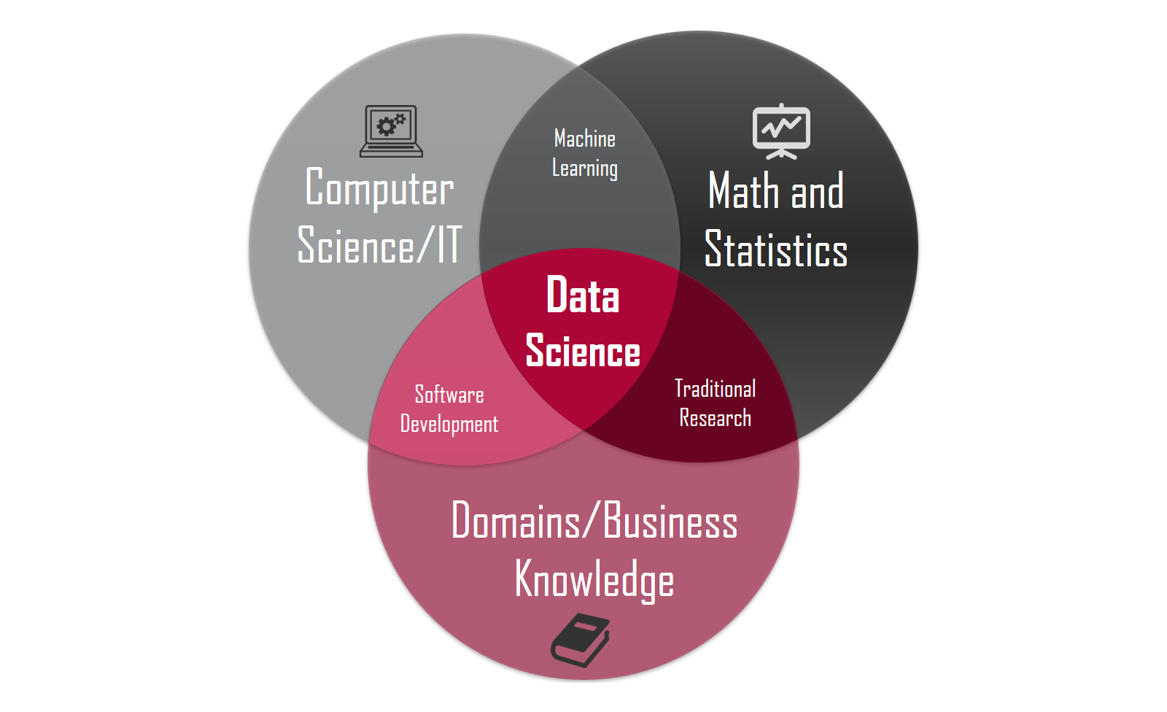

Slide 7
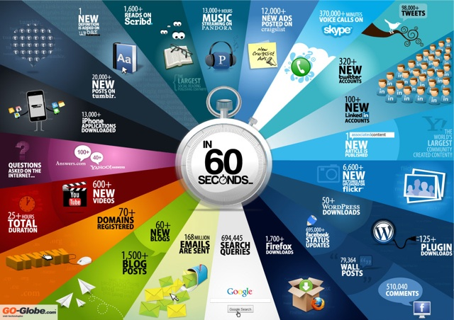
Why DM?

Slide 8
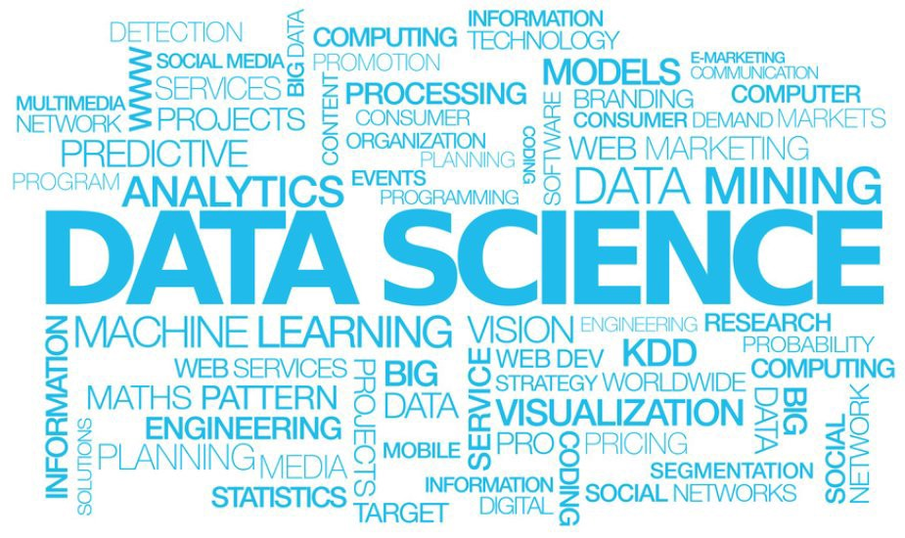

Slide 9
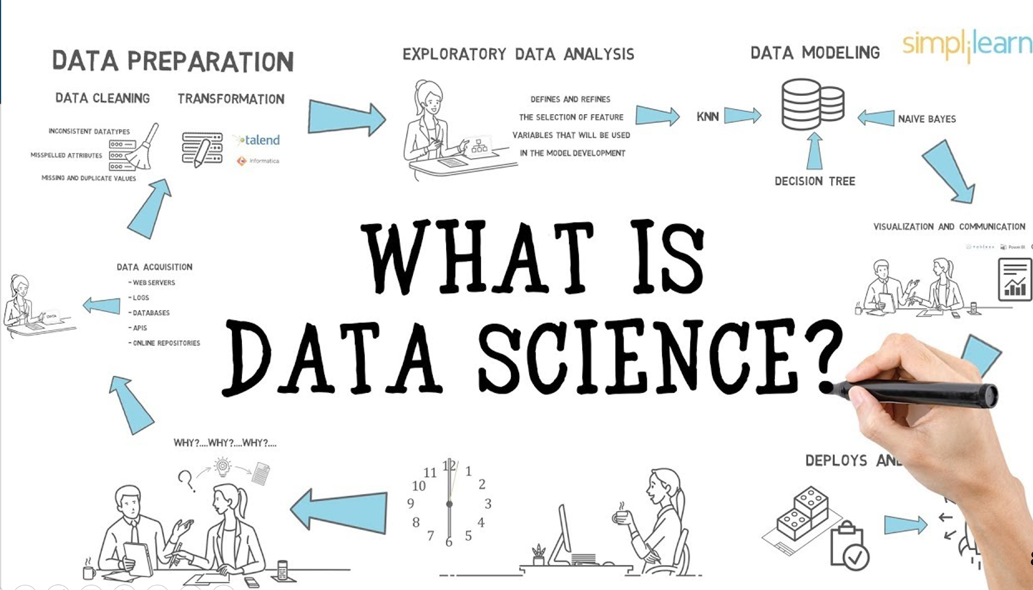

Slide 10
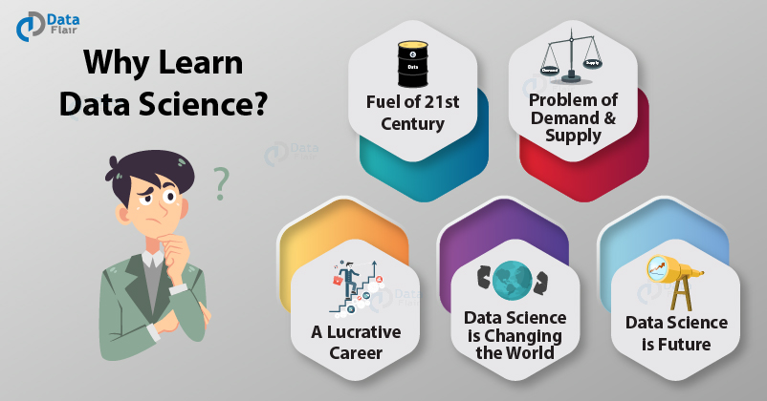

Slide 11
Course Outline
Main Topics
Algorithms
Tools
And
Semester Plan

Slide 12
Introduction to Data Mining
Introduction to Data Mining
Position of DM in CS domain,
Applications
Types of Basic DM techniques:
(Background math/stat, Algorithms, examples, applications)
Association Rule Mining
Classification
Clustering
Text Mining
Graph Mining
Notes:
I BELIEVE WE MAY NEED TO DO IT IN MORE IN-DEPTH INTRODUCTION, USING SOME EXAMPLES. So it will take one slide for one function, i.e., one chapter we want to cover. Do we need to cover chapter 2: preprocessing and 3. Statistical methods?

Slide 13

Introduction to Data and Preprocessing
Introduction to Data
Understanding data
Types of Datasets
Types of Features of Data
Introduction to Data Preprocessing
Steps for Data Preparation
Data Mining/Processing Steps
Notes:
I BELIEVE WE MAY NEED TO DO IT IN MORE IN-DEPTH INTRODUCTION, USING SOME EXAMPLES. So it will take one slide for one function, i.e., one chapter we want to cover. Do we need to cover chapter 2: preprocessing and 3. Statistical methods?

Slide 14

Association Rule Mining
What is Market Basket Analysis
Introduction, Motivation and Application
Frequent Itemset Analysis
Support and Confidence
Algorithms:
Apriori
Frequent Pattern Analysis using Rules
Advanced Concepts: Lift, conviction
Tools:
WEKA

Slide 15
Classification
Classification or label prediction
Construct models based on some training examples
Describe and distinguish classes or concepts for future prediction
Predict some unknown class labels
Typical methods
Decision trees, naïve Bayesian classification, K-Nearest Neighbor, neural networks, etc
Typical applications:
Sentiment Classification,
Spam Classification,
Disease Prediction,
Match result prediction

Slide 16
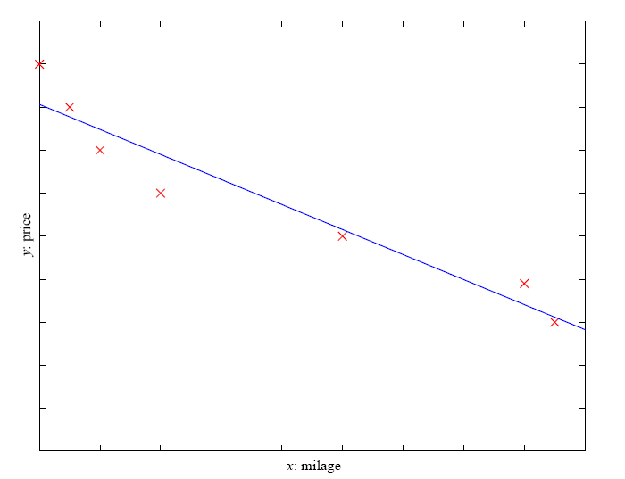
Regression
Prediction of numeric value
Based on Relationship between two variables, Prediction of one Value of a variable
Example: Price of a used car
x : car attributes, y : price
Applications:
Stock Exchange Prediction
Dollar Rate Prediction
y = wx+w₀

Slide 17
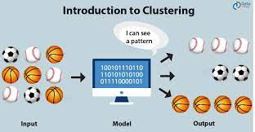
Clustering
Group data to form new categories (i.e., clusters)
Principle:
Maximizing intra-class similarity & minimizing interclass similarity
Algorithms
K-means
K-medoid
Agglomerative Clustering
Hierarchical approach

Slide 18
Text Data Analysis
Introduction to Text Data Analysis/NLP
Stemming
POS Tagging
Bag of Words
N-gram
Similarity Measures
Vector Space Model/ Cosine Similarity
Other Similarity and Distance Measures

Slide 19
Graph (Link) Data Analysis
Graph mining
Graph as Link or Network based modelling structure
Graph Applications
Algorithms
Basic Graph Processing
HITS
PageRank
Notes:
This chapter will not be in the new version, will it?
BUT SHOULD WESTILL INTRODCE THEM SO THAT THEY WILL GET AN OVERALL PICTURE?

Slide 20
Social Network Mining
Information network analysis
Social networks: actors (objects, nodes) and relationships (edges)
e.g., author networks in CS, terrorist networks
Network Analysis using Centrality Measures
Degree Centrality
Closeness Centrality
Betweenness Centrality
Tools for Graph Mining
Gephi/NodeXL/etc

Slide 21
Real World Data analysis [Practical Projects]
Relevant CASE STUDIES
Mainly carried out using Modelling based predictions using Classification algorithms/Recommendation algorithms/Graph and Text Data
Use of Python is highly recommended
Assignments
Text Data analysis, Graph data analysis, Market Basket Analysis, Predictions
Projects
Diverse Data topics such as Recommender System, Sentiment Analysis, Predictive Modelling, etc.
TOOLS
Weka
RapidMiner/KNIME etc
Microsoft Azure latest versions

Slide 22
Libraries and Tools (for assignments and Project)
Python based Implementation
Basic Libraries including Matplotlib
ScikitLean
TensorFlow/Keras
Note: R or any other relevant language is also allowed.
Tools
Weka
RapidMiner
Note: Any other tool like Knime, ORANGE, etc., is also allowed

Slide 23
Resources: Datasets
HUGE HELP FOR DATA SCIENTISTS
GOOGLE DATASET SEARCH
https://datasetsearch.research.google.com/
Kaggle https://www.kaggle.com/
UCI Repository: http://www.ics.uci.edu/~mlearn/MLRepository.html
UCI KDD Archive: http://kdd.ics.uci.edu/summary.data.application.html
Statlib: http://lib.stat.cmu.edu/
Delve: http://www.cs.utoronto.ca/~delve/

Slide 24
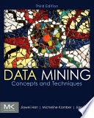
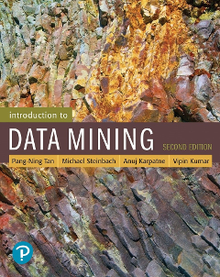
Related Books
Data Mining: Concepts and Techniques
Jaiwei Han and others
Introduction to Data Mining
Pang-Ning Tan

Slide 25
Marks Distribution
Assignments (10 marks)
Quizzes (10-15 marks)
Project (10-15 marks)
Mid Term (20 marks)
Terminal Exam (40-50 marks)

Slide 26
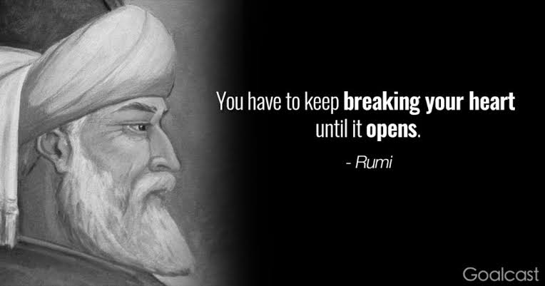

GOOD BEGINNING IS HALF DONE

